Slide 1



Movies Analysis
Presentation
Govind singh shekhawat

Slide 2




Dataset overview
Generated a dataset by mackroo having 1,000 movies with details on title, date, duration, country, language, genre, and revenue.
Key Features: Includes categorical (genre, country), numerical (duration, rating), and financial data.
Use Cases: Trend analysis, revenue forecasting, and genre-based insights.

Slide 3

Aim of the project
Analyze Trends: Identify patterns in movie genres, ratings, and revenue over time.
Revenue Insights: Examine factors influencing worldwide gross income
Audience Preferences: Understand how ratings vary by genre, country, and language.
Making a dynamic dashboard using tableau including all factors and visuals

Slide 4
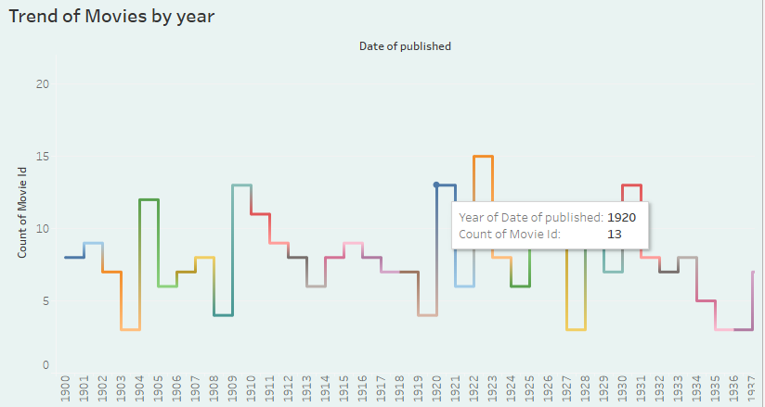
Insights and trends
Trend: The number of movies released fluctuated from 1900 to 1937, peaking in 1920 with 13 movies.
Observation: Irregular patterns suggest industry or historical influences on movie production.

Slide 5
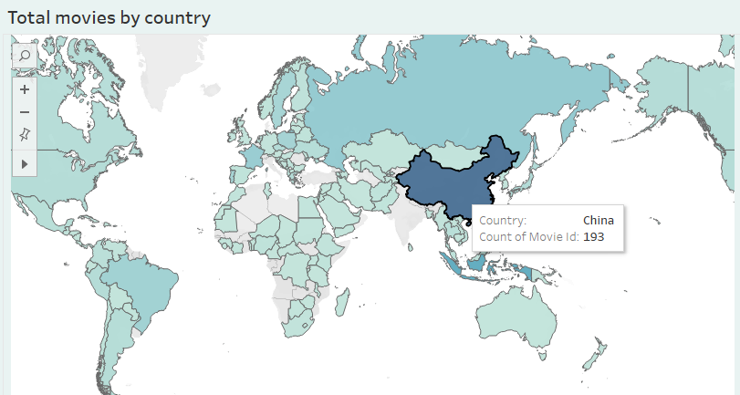
Insights and trends
Highest Movie Production: China produced the most movies (193) compared to other countries.
Global Distribution: Movie production varies worldwide, with darker shades indicating higher output.

Slide 6
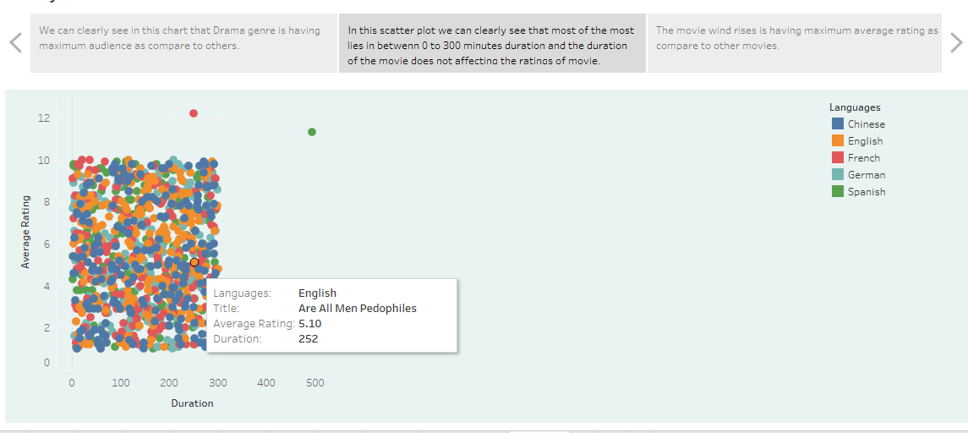
Storytelling using tableau

Slide 7
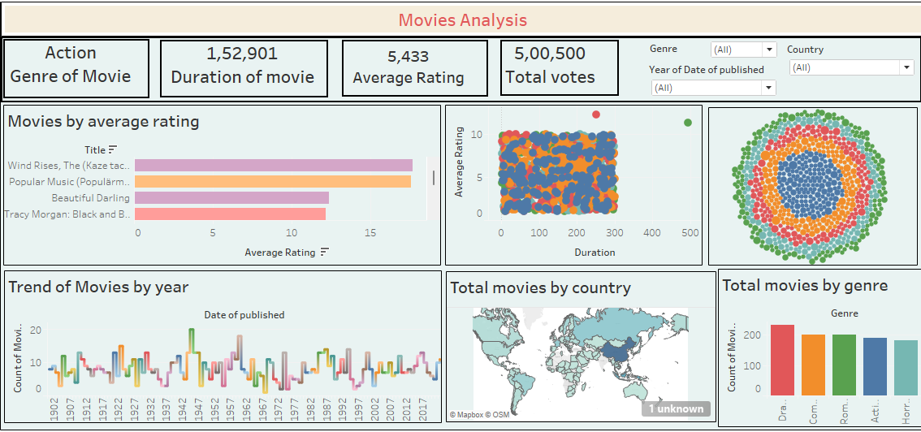
Dashboard Overview

Slide 8

Conclusion
Movie production has fluctuated over time, with some peaks indicating high activity in specific years.
China leads in movie production, while other countries contribute significantly.
The average rating varies widely, with some movies achieving exceptionally high ratings.
Different genres contribute almost equally to total movie production.
The relationship between duration and rating shows no strong correlation, suggesting that longer movies do not necessarily receive higher ratings.

Slide 9

Recommendations
For Filmmakers: Focus on high-rated genres to improve audience engagement and success.
For Investors: Consider countries with high movie production for potential investment opportunities.
For Analysts: Further analyze factors influencing ratings and revenue for better insights.

